Slide 1

Blockchain

Slide 2
Group Members
Under The Guidance Of V.G. Khetade Sir
NAME | PRN
Shreyash Tembhurne | 19UCS130
Dhairyashil Shinde | 19UCS122
Gourav Shinde | 19UCS124
Pritesh Shetty | 19UCS122

Slide 3
Index
1. Introduction
2. History of Blockchain
3. Types of Systems
4. Current Banking Systems
5. Issues with Banking Systems
6. How Blockchain Works?
7. Blockchain Applications
8. Conclusion of Blockchain Technology
9. Use Cases
10. Reference

Slide 4
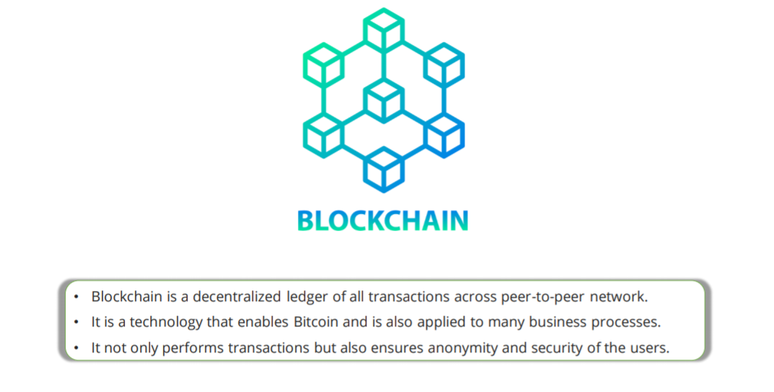

Slide 5
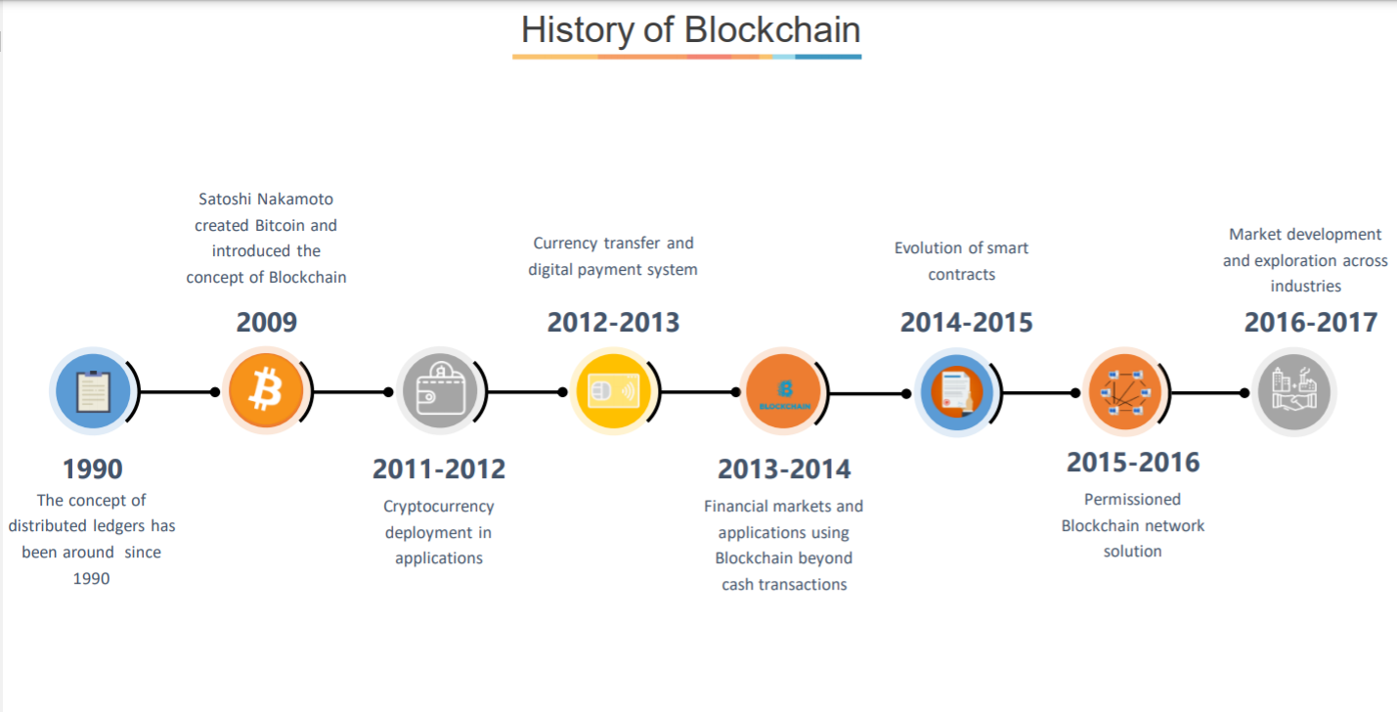

Slide 6
Types of Systems..

Slide 7
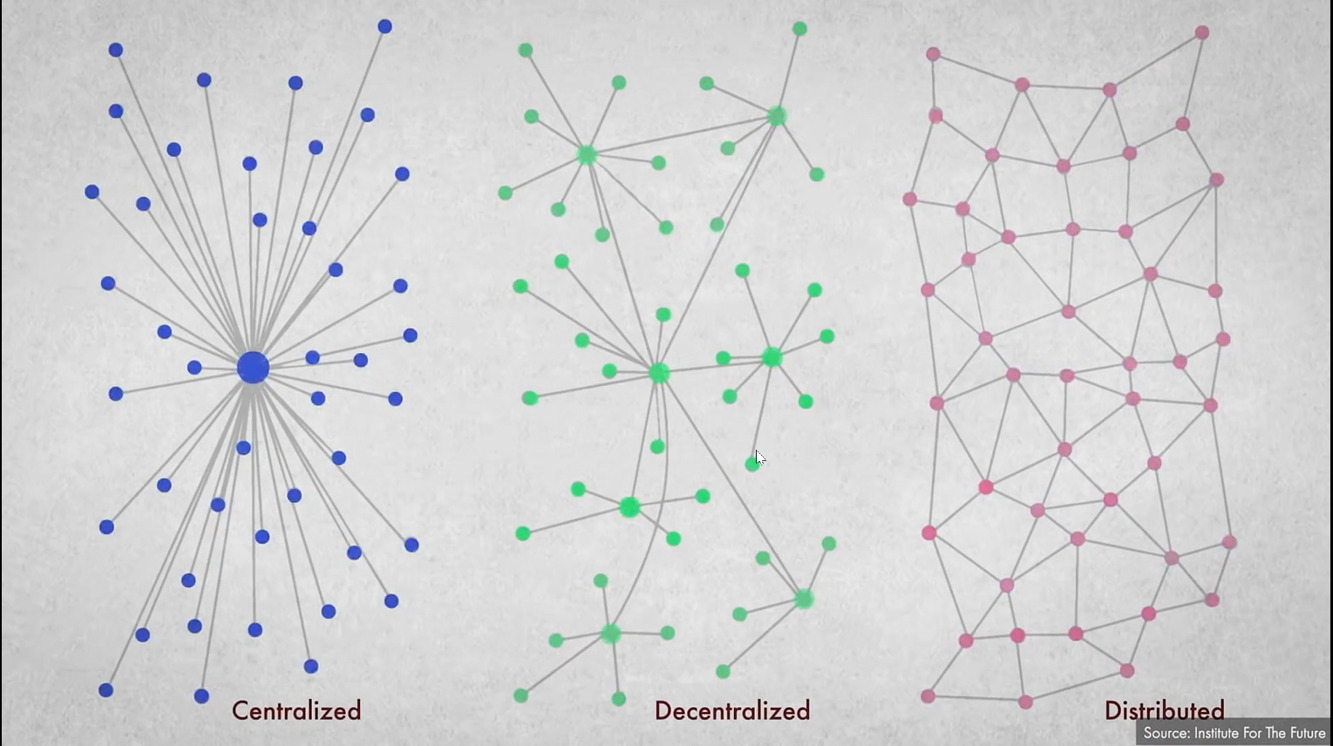

Slide 8
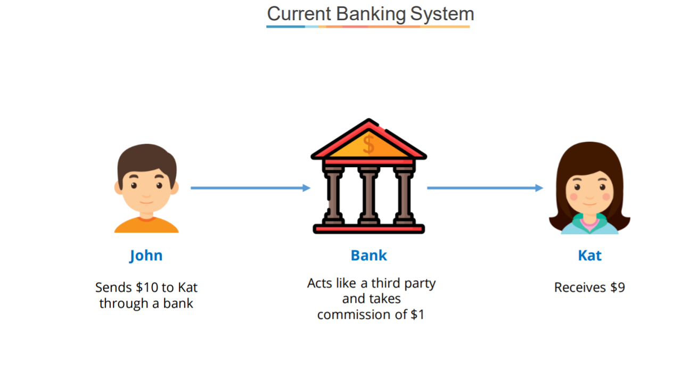

Slide 9
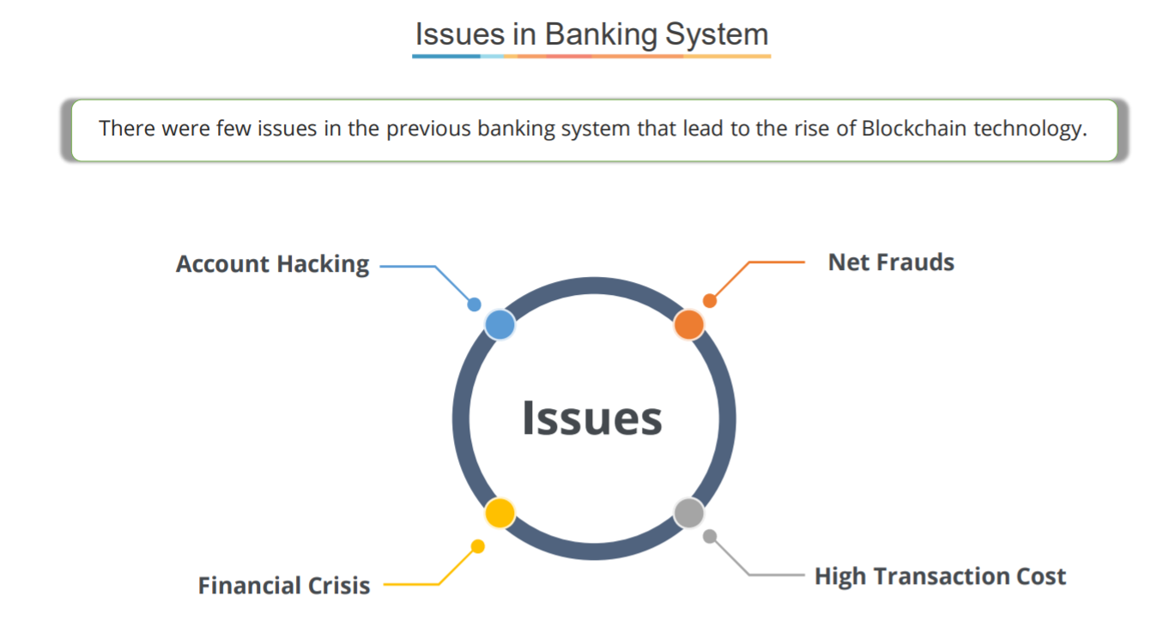

Slide 10
How Blockchain Works ?

Slide 11
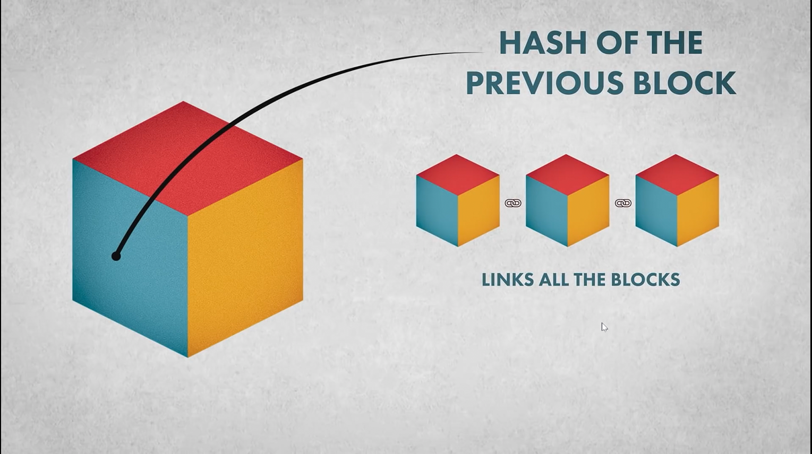

Slide 12
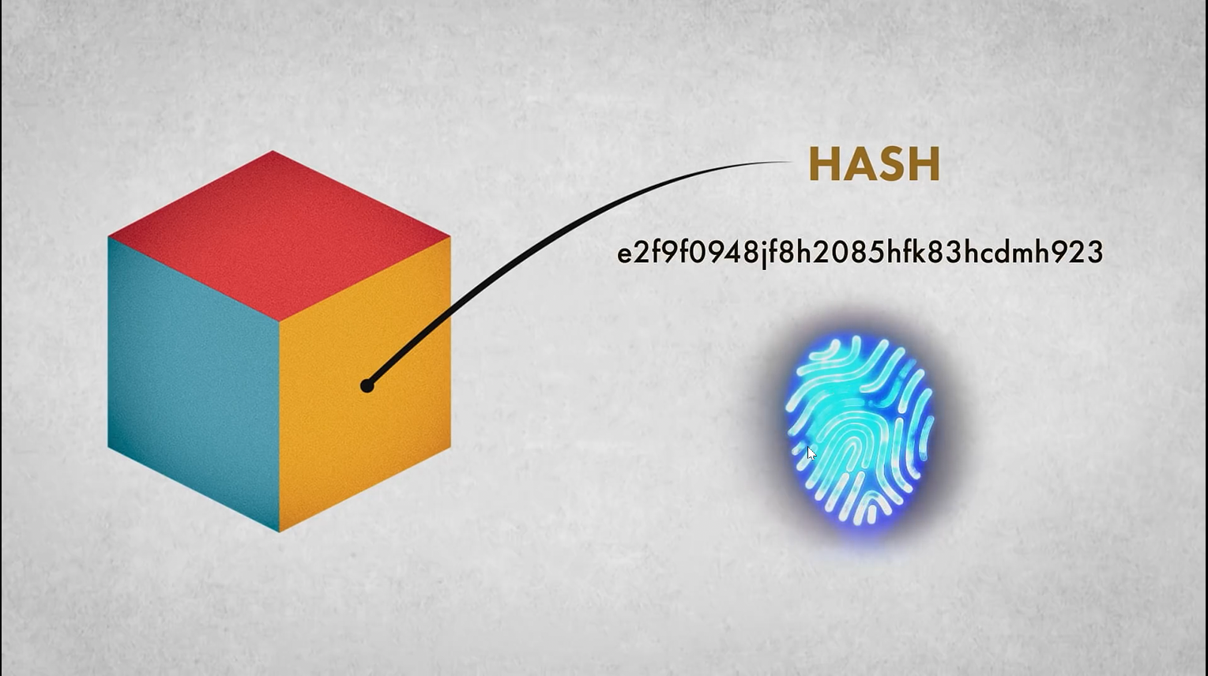

Slide 13
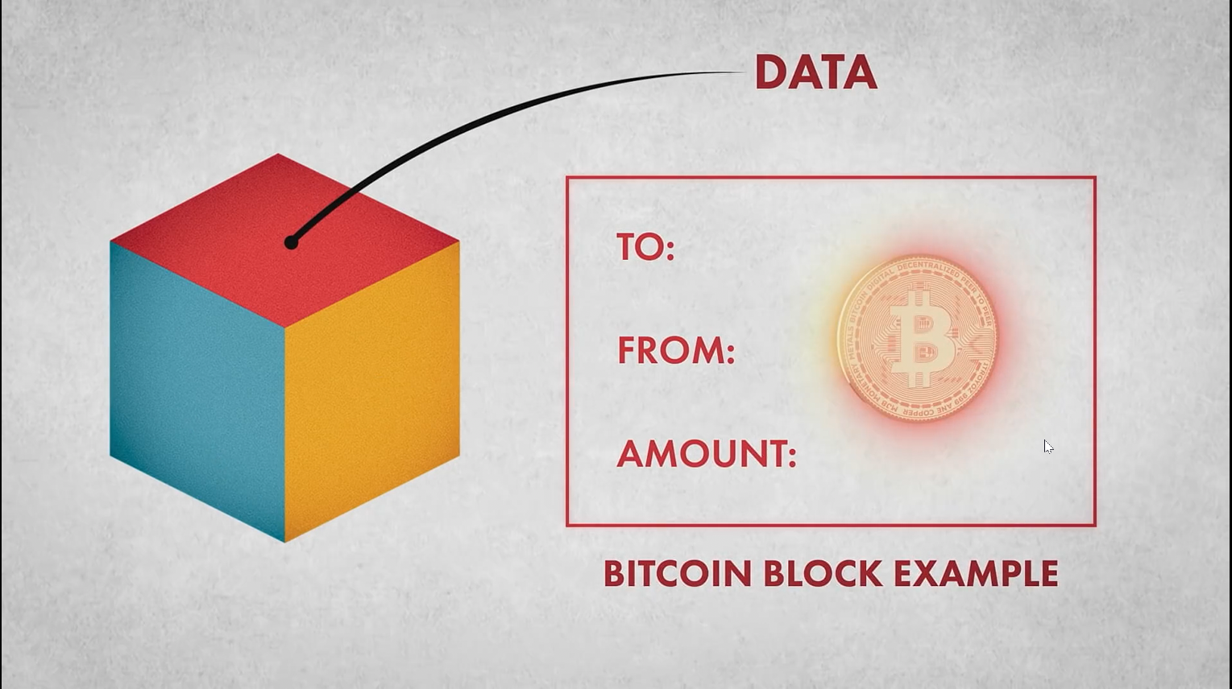

Slide 14
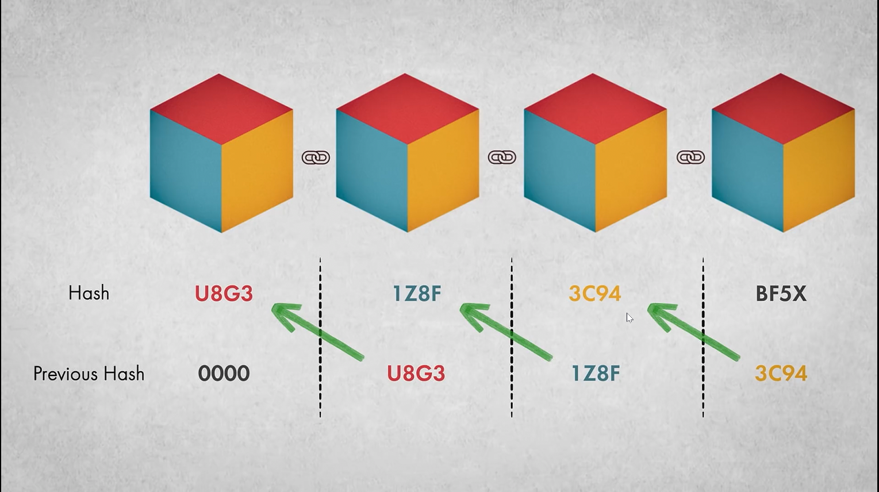

Slide 15
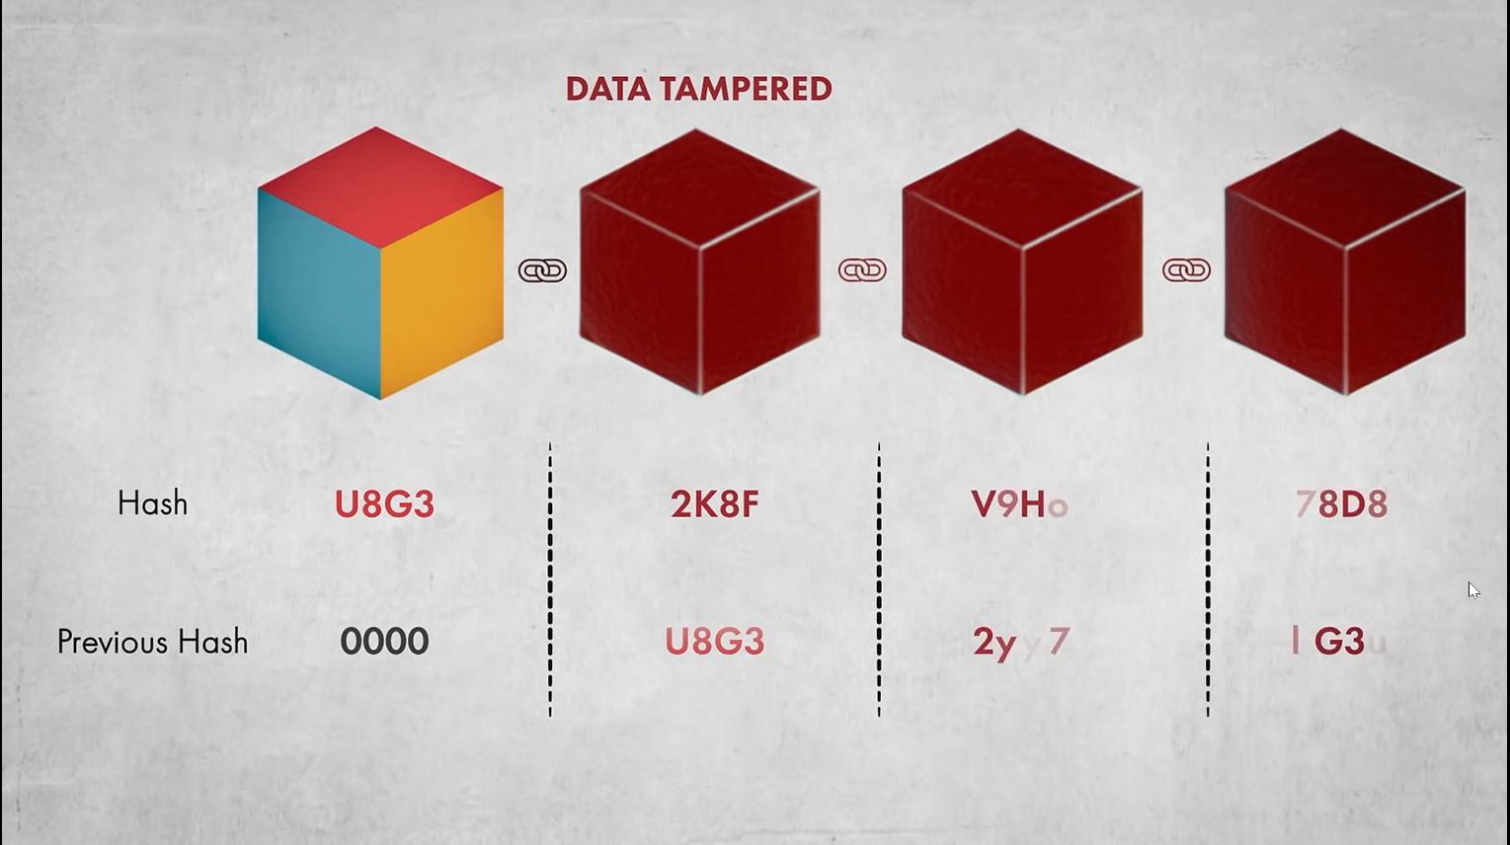

Slide 16
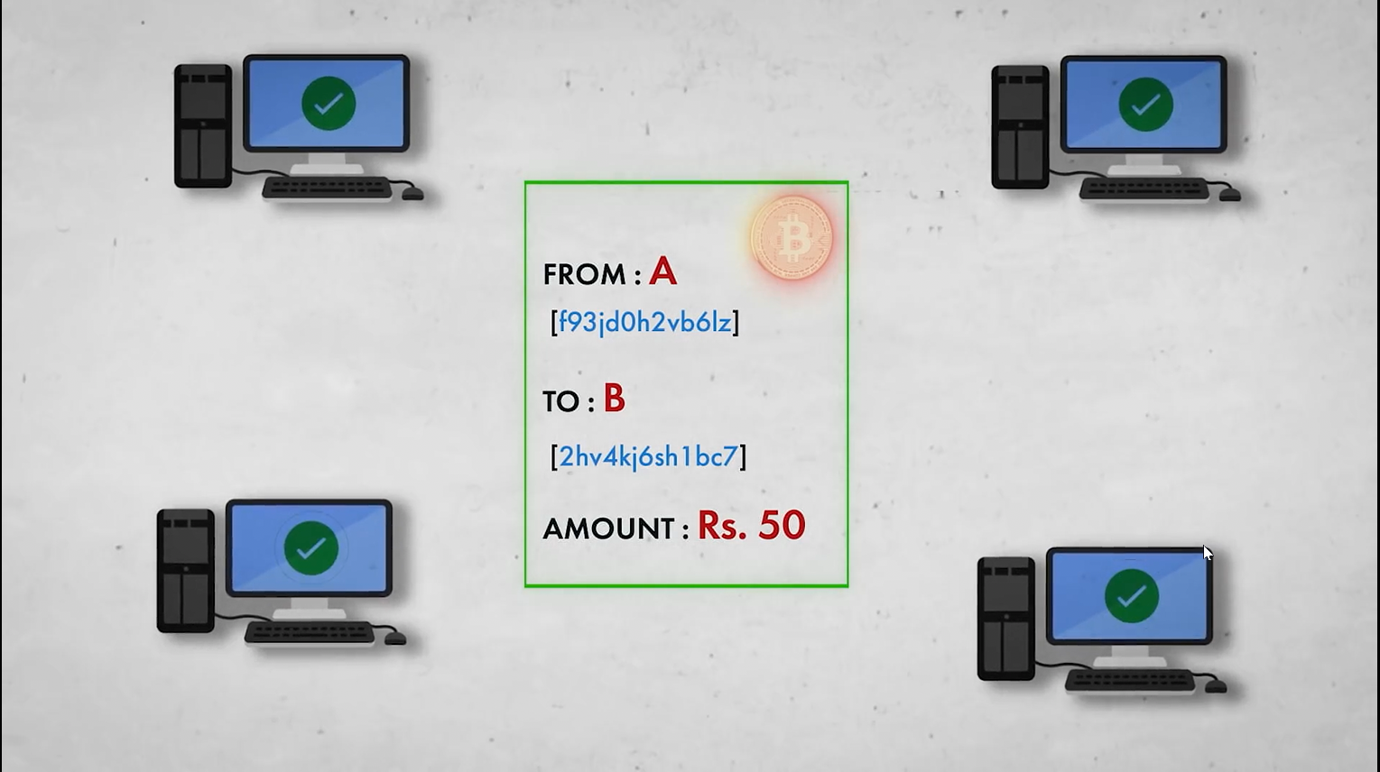

Slide 17
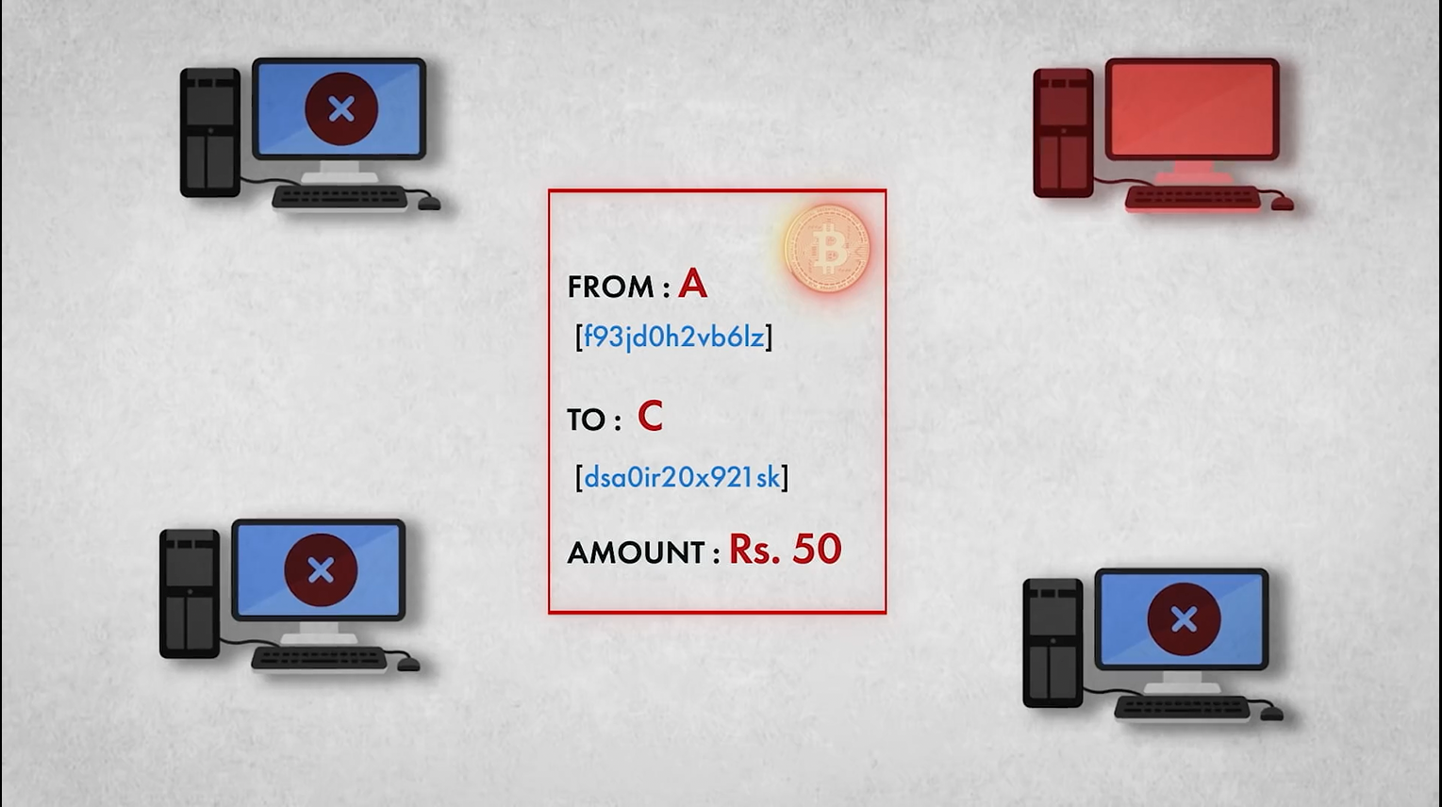

Slide 18
Blockchain Applications
Secure sharing of medical data
NFT marketplaces
Music royalties tracking
Cross-border payments
Real-time IoT operating systems
Personal identity security
Anti-money laundering tracking system
Supply chain and logistics monitoring
Voting mechanism
Advertising insights
Original content creation
Cryptocurrency exchange
Real estate processing platform

Slide 19
Conclusion of Blockchain Technology
The Bitcoin is the first successful implementation of blockchain.
Today, the world has found applications of blockchain technology in several industries, where the trust without the involvement of a centralized authority is desired.

Slide 20
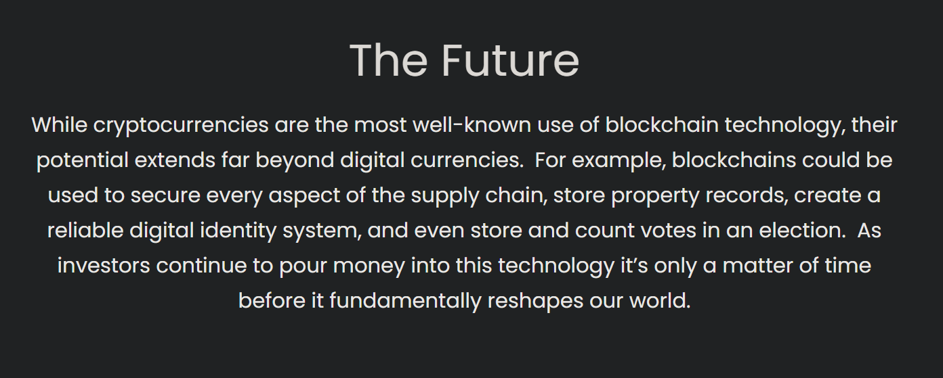

Slide 21
Use Cases

Slide 22
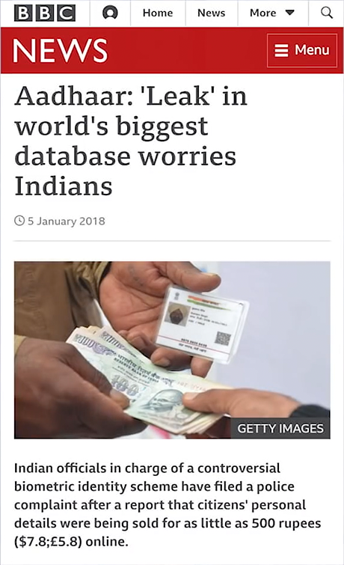
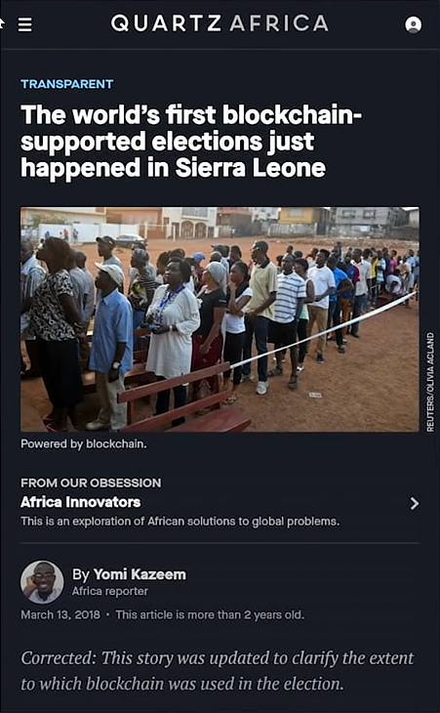

Slide 23
https://youtu.be/ENrjn-lD1e8
https://youtu.be/YJyXfjbBmc8
https://101blockchains.com/blockchain-fundamentals-presentation/
References

Slide 24
Any Question ?

Slide 25
Thank You!

